Slide 1
Introduction to Respiration and Mechanics of Ventilation
Dr. Tabish Masood Ranjha

Slide 2
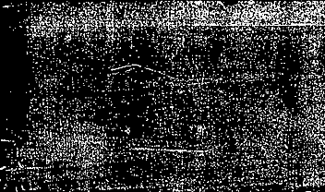
INTRODUCTION
Respiration is the process by which oxygen is taken in and carbon dioxide is given out.

Slide 3
TYPES OF RESPIRATION
Respiration is classified into two types:
1. External respiration
It involves exchange of respiratory gases, i.e. oxygen and carbon dioxide between lungs and blood.
2. Internal respiration
It involves exchange of gases between blood and tissues.

Slide 4

PHASES OF RESPIRATION
Respiration occurs in two phases:
Inspiration during which air enters the lungs from atmosphere.
Expiration during which air leaves the lungs.
During normal breathing, inspiration is an active
process and expiration is a passive process.

Slide 5
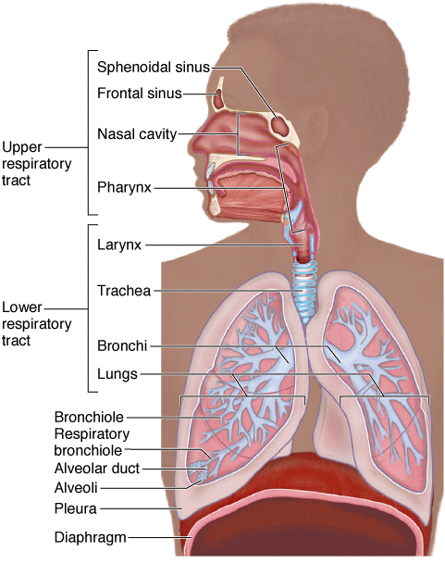
Upper and Lower Respiratory Tracts
Respiratory tract is divided into two parts:
1. Upper respiratory tract that includes all the
structures from nose up to vocal cords; vocal cords are the folds of mucous membrane within larynx that vibrates to produce the voice
2. Lower respiratory tract, which includes Larynx, trachea, bronchi and lungs.

Slide 6
RESPIRATORY UNIT
“The structural and functional unit of lung”.
Exchange of gases occurs only in this part of the respiratory tract.
STRUCTURE OF RESPIRATORY UNIT
1. Respiratory bronchioles
2. Alveolar ducts
3. Alveolar sacs
4. Antrum
5. Alveoli

Slide 7
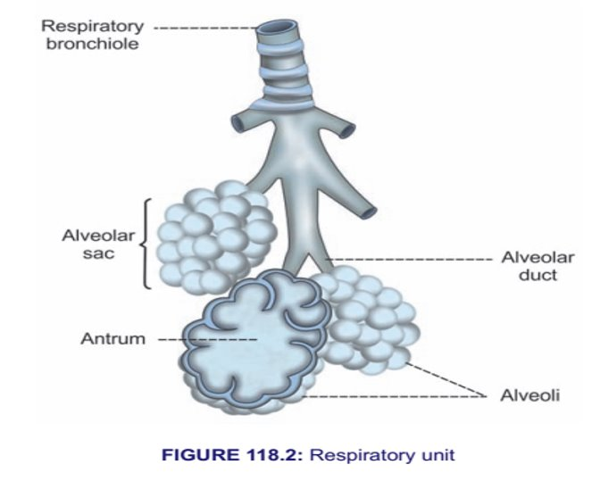
Between the trachea and alveoli airways divide 23 times
Out of 23 divisions first 16 are just to conduct air and these divisions of airways are up to terminal bronchioles.
The last 7 divisions are for the exchange of gases and these divisions which are for exchange of gases includes respiratory bronchioles, alveolar ducts and alveoli.
There are 300 million alveoli in the lungs and the alveolar surface form s an area of 70-100 square meters

Slide 8
Alveolar Cells or Pneumocytes
Type I alveolar cells
Type II alveolar cells
Type I alveolar cells are the squamous epithelial cells
They are about 95% of the total number of cells.
These cells form the site of gaseous exchange between the alveolus and blood.
Type II alveolar cells are cuboidal in nature.
They are about 5% of alveolar cells.
These cells are also called granular pneumocytes.
Type II alveolar cells secrete alveolar ﬂuid and surfactant
Notes:
Great—Alveolar Cells (Pneumocytes) is a very important respiratory physiology topic. Let’s make it simple, structured, and exam-ready 😊
🫁 Alveolar Cells (Pneumocytes)
🔹 Definition
Alveolar cells are the cells lining the alveoli (air sacs) of the lungs, where gas exchange occurs.
👉 Main function: exchange of O₂ and CO₂
🧩 Types of Alveolar Cells
1️⃣ Type I Pneumocytes
🔬 Structure:
Thin, flat cells
Cover about 95% of alveolar surface
⚙️ Function:
Main site of gas exchange
Allows:
Oxygen → into blood
Carbon dioxide → out
👉 Very important for diffusion
2️⃣ Type II Pneumocytes
🔬 Structure:
Round/cuboidal cells
Fewer in number
⚙️ Functions:
🫧 a. Surfactant Secretion
Produces surfactant 👉 Reduces surface tension 👉 Prevents alveoli from collapsing
🔄 b. Repair Function
Can divide and replace:
Type I cells
Damaged alveolar cells
3️⃣ Alveolar Macrophages (Dust Cells)
⚙️ Function:
Engulf:
Dust
Bacteria
👉 Important for lung defense
⚖️ Summary Table
Cell TypeFunctionType IGas exchangeType IISurfactant + repairMacrophagesDefense🧠 Short Exam Answer (Write This!)
Alveolar cells, or pneumocytes, line the alveoli and are of two main types. Type I pneumocytes are thin cells responsible for gas exchange, while Type II pneumocytes secrete surfactant and help in repair. Alveolar macrophages provide immune defense.
⚡ Memory Trick
“1 = Exchange, 2 = Surfactant, M = Macrophage (defense)”
If you want, I can next explain surfactant in detail + neonatal respiratory distress (very common exam question) 🔥

Slide 9
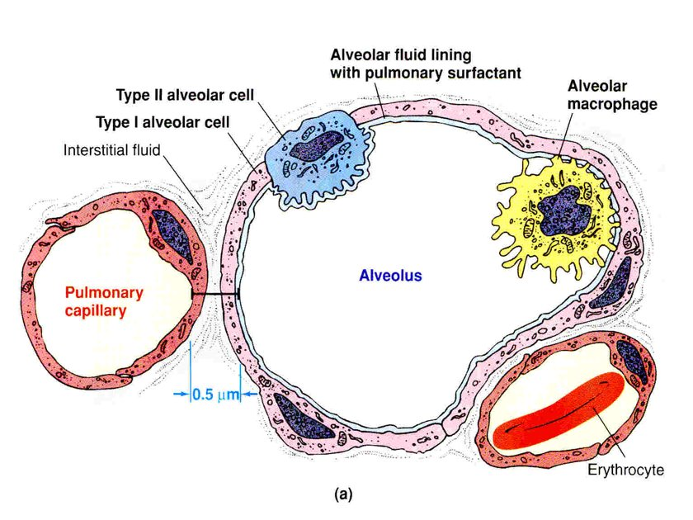

Slide 10
Functions of lungs

Slide 11
Non Respiratory functions
Besides primary function of gaseous exchange, the respiratory system is involved in several non-respiratory functions of the body
Olfaction
Vocalization
Filtration of dust particles
Immunological defense system
Maintenance of water balance
Regulation of body temperature
Regulation of acid-base balance
Anti-coagulant function
Secretion of angiotensin converting enzyme

Slide 12
Non-respiratory functions
OLFACTION
Olfactory receptors present in mucus membranes of the nostrils are responsible for olfactory sensation
VOCALIZATION
Larynx alone plays a major role in the process of vocalization. Therefore its also called sound box.
REMOVAL OF DUST PARTICLES
Particles which escape the protective mechanisms in nose and alveoli are thrown out by cough reflex and sneeze reflex.

Slide 13
DEFENSE MECHANISM
Lungs play an important role in the immunological defense system of the body. This function is performed by the presence of various cells lining the membrane of alveoli. These cells are leucocytes, macrophages, mast cells, natural killer cells, dendritic cells.
MAINTENANCE OF WATER BALANCE
Respiratory tract plays a role in water loss mechanism. During expiration, water evaporates through the expired air and some amount of body water is lost by this process.
REGULATION OF BODY TEMPERATURE
As water evaporated during expiration, so does heat from the body. Hence, body temperature maybe regulated by respiration.
REGULATION OF ACID BASE BALANCE
Acid base balance is maintained by regulating the carbon dioxide content in the blood.

Slide 14
ANTICOAGULANT FUNCTION
Mast cells in the lungs secrete Heparin. Heparin is an anti coagulant and prevents intravascular clotting.
SECRETION OF ACE
Endothelial cells of the pulmonary capillaries secrete the angiotensin converting enzyme (ACE). It converts Angiotenisin I to active Angiotensin II, which plays an important role in regulation of ECF volume and blood pressure.

Slide 15
Mechanics of Pulmonary Ventilation

Slide 16
Pressures in the Thorax
Pleural Pressure
Alveolar Pressure
Transpulmunary Pressure

Slide 17

Pleural Pressure
Pressure in the pleural cavity.
Two types of pleura i.e. visceral and parietal. A potential space is present in between them.
The pressure in this space is usually negative which causes lung expansion and is called pleural pressure. When this pressure becomes positive lungs are collapsed.
Generation of Pleural pressure:
Lungs are collapsed in intrauterine life. During birth baby cries very strongly as a result of which thoracic wall expands and negative pleural pressure is produced.

Slide 18
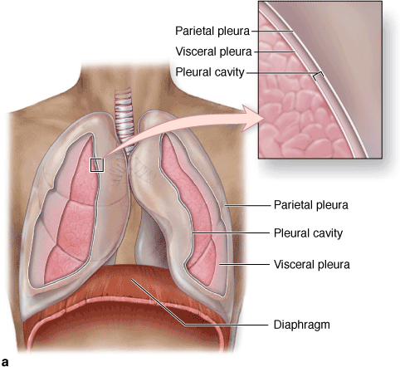

Slide 19
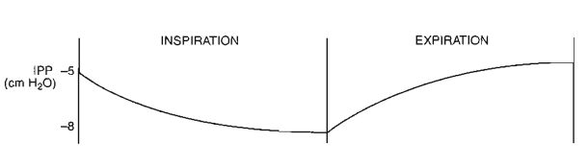
Pleural Pressure
Pleural pressure normally:
At the start of quiet inspiration is -5 cm of H2O
At the end of quiet inspiration is -8 cm of H2O
At the end of maximal deep inspiration it may becomes equal to – 30 mm of Hg

Slide 20
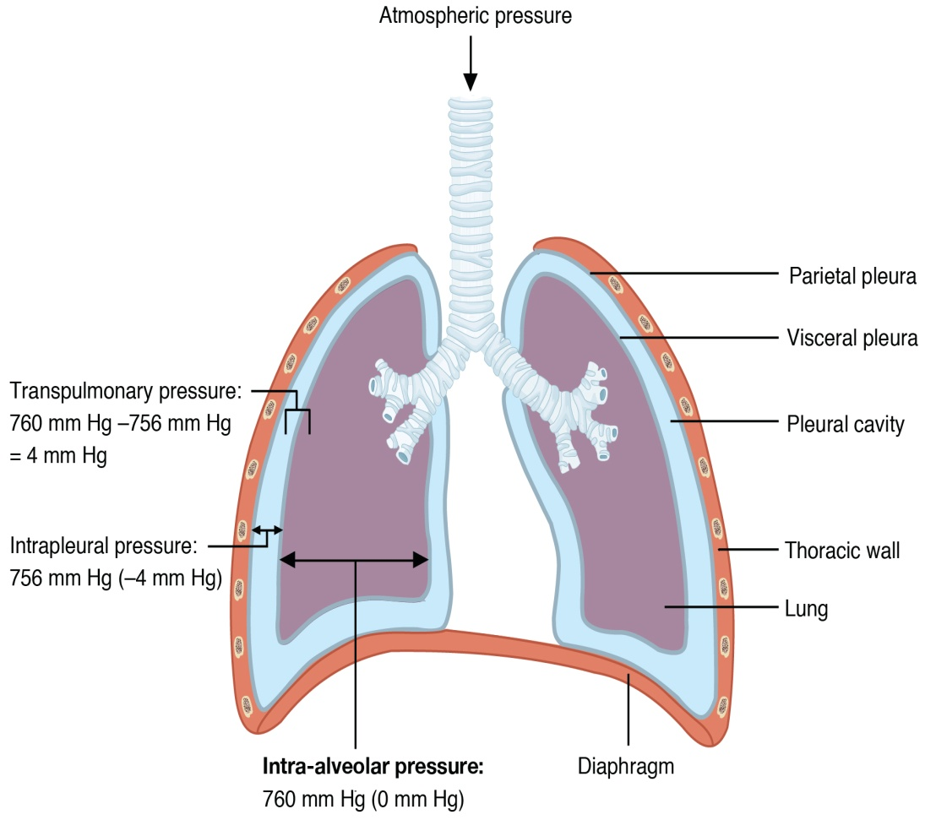
Alveolar Pressure
Pressure inside the alveoli
Alveolar pressure normally:
At the start of quiet inspiration is 0 cm of H2O
It becomes negative during inspiration and positive during expiration.
During maximal deep inspiration it may becomes equal to - 100 mm of Hg
During maximal forceful expiration with glottis closed it may becomes equal to +140 mm of Hg

Slide 21
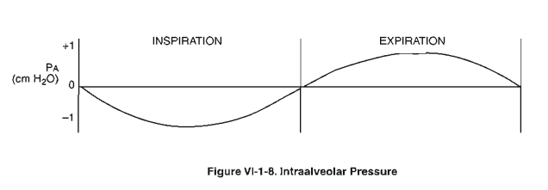

Slide 22
Transpulmunary Pressure
Difference between alveolar pressure and pleural pressure.
This is actually recoil pressure i.e. the pressure with which lungs tend to recoil back or shorten back. This is the recoil tendency of lungs.
MECHANISM OF RECOIL TENDENCY:
Lungs contain elastic tissue which tends to shorten back
On the inner surface of alveoli, a thin layer of fluid is present which has got surface tension which contributes to recoil tendency.

Slide 23
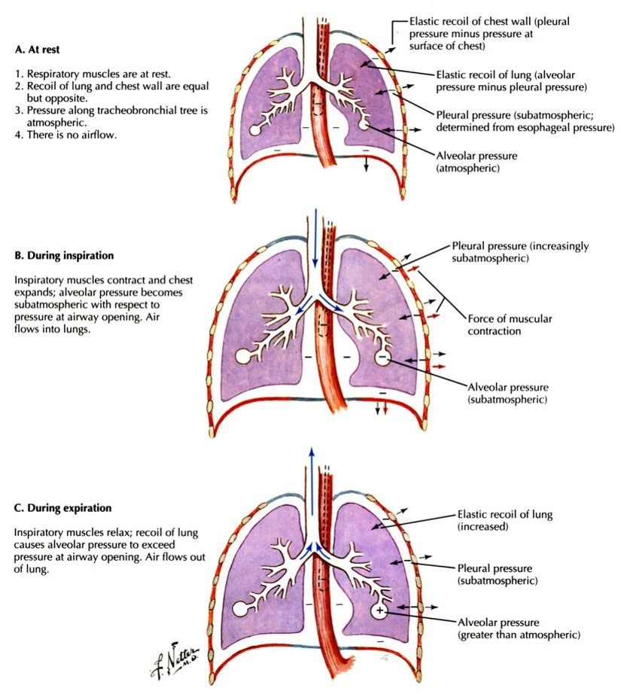

Slide 24
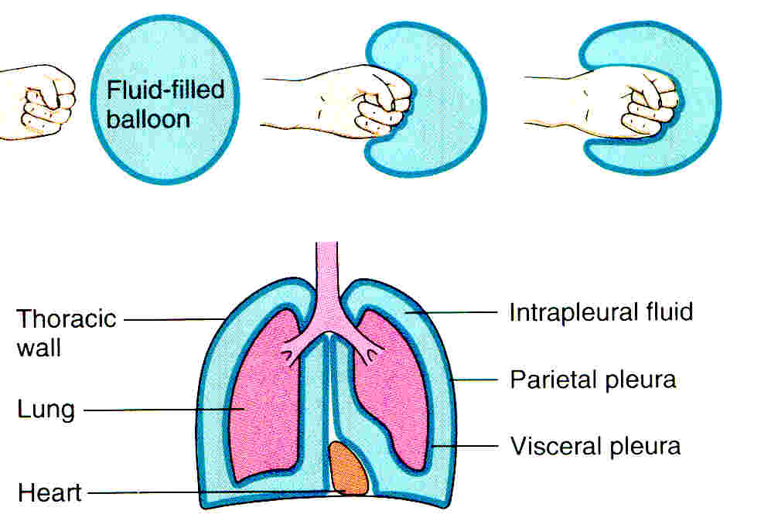

Slide 25
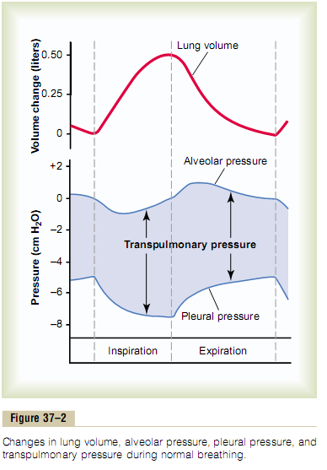

Slide 26
MECHANICS OF PULMUNORY VENTILATION
Movement of air into and out of the lungs is pulmonary ventilation i.e. inspiration and expiration which are brought about by the changes in the size and volume of the thoracic cavity with the lungs following these changes passively.
Inspiration
Expiration

Slide 27
MECHANICS OF INSPIRATION
Contraction of Inspiratory Muscles
Thorax expands
P_{ip} becomes more sub atmospheric
Increased Transpulmonary pressure
Lungs expand
P_{alv} becomes sub atmospheric
Air flows into alveoli
Notes:
Great — this slide is VERY important (mechanism of inspiration). I’ll explain it step-by-step exactly like your slide so you can understand + explain in presentation easily.
🌬️ MECHANISM OF INSPIRATION (Line by Line Explanation)
1. Contraction of Inspiratory Muscles
👉 Muscles involved:
Diaphragm
External intercostals
✔ When they contract:
Diaphragm moves down
Ribs move up and out
👉 This increases chest size (Physiology)
2. Thorax expands
👉 Chest cavity becomes bigger in all directions
✔ Result:
Volume ↑
According to Boyle’s law: 👉 Volume ↑ → Pressure ↓ (TeachMePhysiology)
3. Pip becomes more sub-atmospheric (more negative)
👉 Pip = Pleural pressure
✔ Normally: -5 cm H₂O ✔ During inspiration: becomes more negative (-8)
👉 Why?
Thorax expands → pulls lungs outward
👉 This negative pressure keeps lungs expanded (Deranged Physiology)
4. Increased Transpulmonary Pressure
👉 Formula: Transpulmonary = Palv − Pip
✔ Pip becomes more negative → difference increases ✔ So transpulmonary pressure ↑
👉 Meaning:
More force to expand lungs
5. Lungs expand
👉 Because:
Pleural pressure pulls lungs outward
✔ Lungs follow thorax movement (they are attached)
6. Palv becomes sub-atmospheric
👉 Palv = Alveolar pressure
✔ When lungs expand:
Pressure inside alveoli ↓
👉 It becomes slightly negative (below atmospheric) (SEER Training)
7. Air flows into alveoli
👉 Golden rule: 👉 Air moves high pressure → low pressure
✔ Outside air pressure > alveolar pressure ➡ Air enters lungs
🔁 FULL FLOW (MEMORIZE THIS FOR EXAM)
👉 Muscle contraction ➡ Thorax expands ➡ Pleural pressure ↓ (more negative) ➡ Transpulmonary pressure ↑ ➡ Lungs expand ➡ Alveolar pressure ↓ ➡ Air enters lungs
🎯 SUPER SIMPLE SHORT VERSION (FOR PRESENTATION)
You can say this:
“During inspiration, the diaphragm and intercostal muscles contract, which expands the thoracic cavity. This makes pleural pressure more negative, increasing transpulmonary pressure and causing the lungs to expand. As the lungs expand, alveolar pressure falls below atmospheric pressure, so air flows into the lungs.”

Slide 28
MUSCLES OF QUIET INSPIRATION
Diaphragm:
Increases the vertical dimension of the thoracic cavity.
Responsible for 75% increase in the size of thoracic cavity during quiet inspiration.
During quiet inspiration descent of diaphragm is 1-1.5 cm and during forceful inspiration it is 7-10cm.
Notes:
“When the diaphragm contracts, it moves downward, increasing the vertical size of the thoracic cavity. This allows the lungs to expand and air to enter. It is responsible for about 75% of air intake during quiet breathing.”
⚡ EASY MEMORY TRICK
👉 Down → Space ↑ → Air In

Slide 29
MUSCLES OF QUIET INSPIRATION
External Intercostal:
They arise from the lower border of rib above and descend down to be inserted on the upper border of lower rib.
When these muscles contract 2 types of movements occur:
Sternum and anterior part of ribs move up in pump handle movements which will increase the anteroposterior part of thoracic cavity
Middle parts of the rib moves up and outwards which increases the transverse diameter of thoracic cavity. These movements are called bucket handle movements
So by the use of diaphragm and external intercostal muscles, thoracic cavity is increased in all dimensions.
Notes:
wo movements:
👉 Pump handle movement
Sternum moves up & forward
Increases front-to-back (AP) diameter
👉 Bucket handle movement
Ribs move outward
Increases side-to-side (transverse) diameter
Found between adjacent ribs
Run from:
Lower border of upper rib
To upper border of lower rib
👉 Direction:
Fibers run downward and forward (like putting hands in pockets)

Slide 30
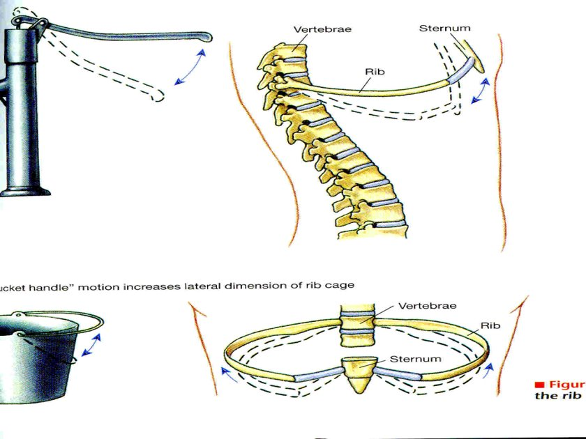

Slide 31
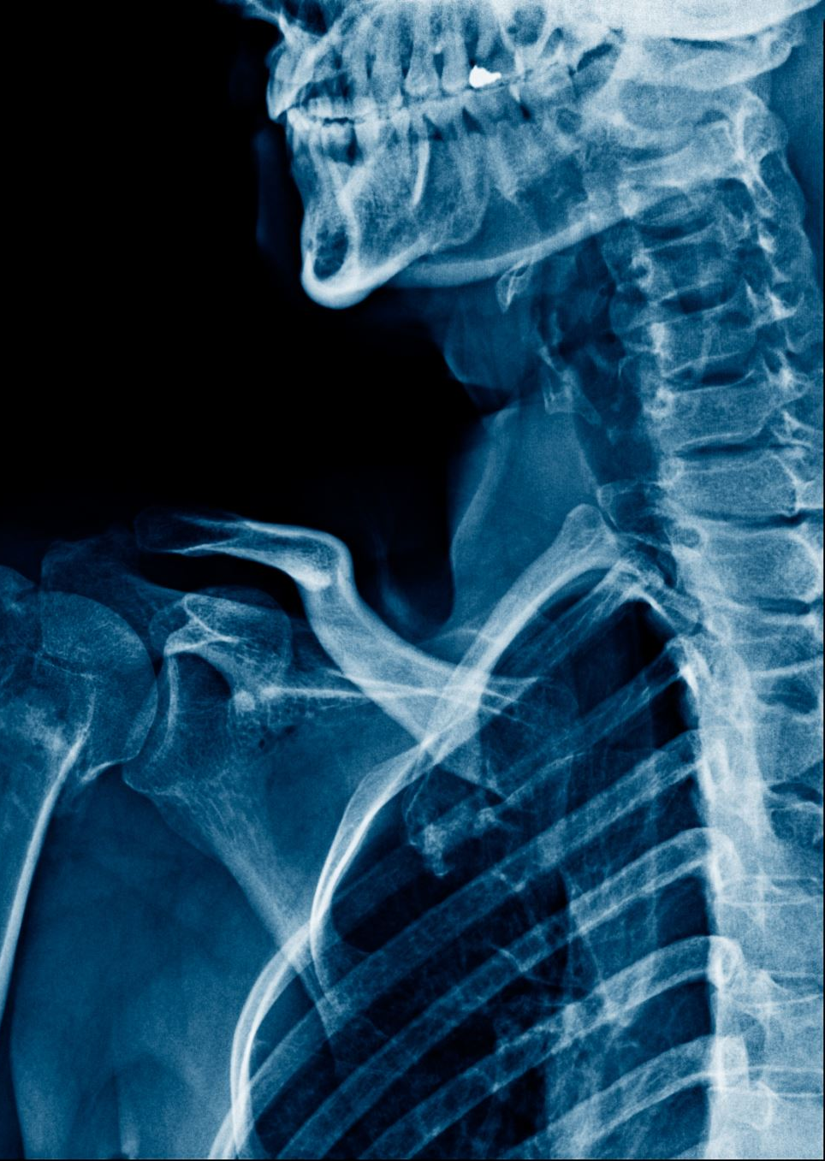

ACCESSORY MUSCLES OF INSPIRATION
These muscles normally don’t contract during quiet inspiration but these contract during deep inspiration like in exercise.
These include
Sternocleidomastoid
Pectoralis minor
Scalene
Serratus anterior

Slide 32
MECHANICS OF EXPIRATION
Relaxation of Inspiratory muscles
Chest wall moves inwards
P_{ip} backs towards pre Inspiratory value
Transpulmonary pressure back towards pre Inspiratory value
Lungs recoil to pre Inspiratory size
Alveolar air compressed
P_{alv} becomes greater than P _{atm}
Air flow out of lungs

Slide 33
Muscles of Expiration
Forceful expiration is an active process and expiratory muscles contract to produce expiration like in exercise, vomiting, sneezing and even during speech.
Expiratory muscles include: Internal intercostals and also muscles of abdominal wall. Abdominal muscles which include internal oblique, external oblique, transverus abdominus and rectus abdominus
When internal intercostals contract size of thoracic cavity decreases in AP and transverse diameter.
Notes:
“Forceful expiration is an active process in which internal intercostal and abdominal muscles contract. This decreases the anteroposterior and transverse diameters of the thoracic cavity, increasing pressure and forcing air out of the lungs.”
⚡ EASY MEMORY
👉 Down + In = Air Out

Slide 34
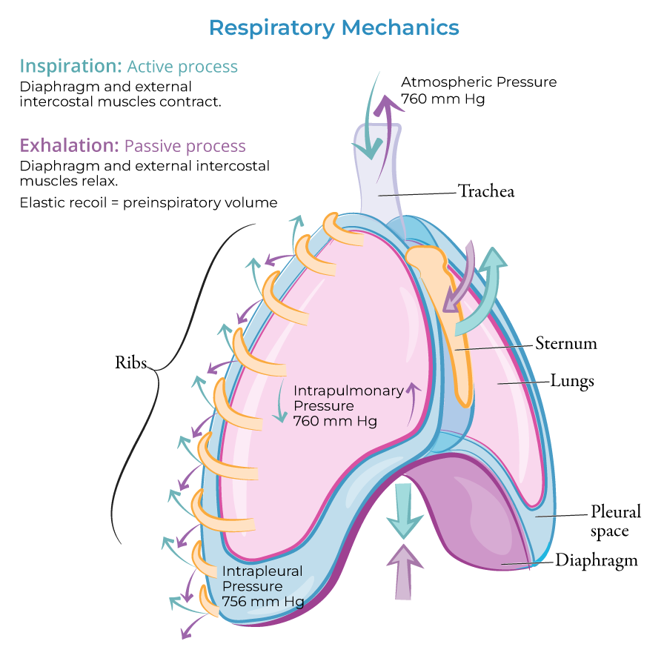

Slide 35
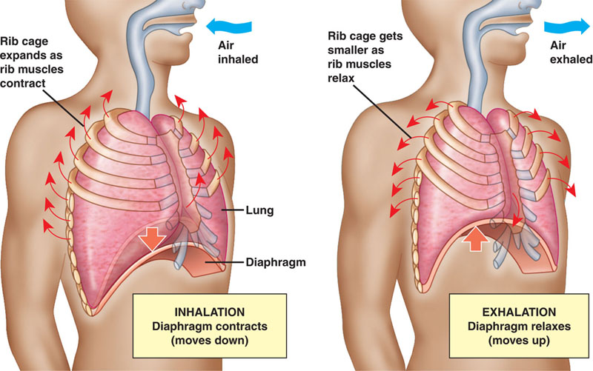

Slide 36
SURFACTANT LUNG COMPLIANCE
Dr. Tabish Masood Ranjha

Slide 37
SURFACTANT
It is a lipoprotein mixture present in thin layer of fluid lining the alveoli at the air fluid interface.
Mainly produced by typeII alveolar cells.
Reduces Surface tension and increases lung compliance.
COMPOSITION
It is composed of
Apoprotein
Calcium ions
Phospholipids i.e. dipalmitoyl lecithin

Slide 38
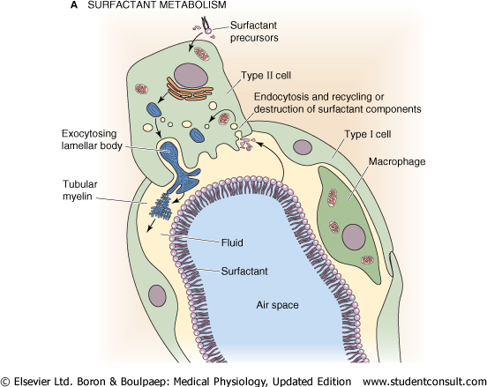

Slide 39
FUNCTIONS OF SURFACTANT
Prevents collapse of lungs
Stabilize size of alveoli
Surfactant helps to keep lungs expanded. If there is deficiency of surfactant then the pressure of -20 to -30 mm of Hg will be required to keep the lungs expanded
Surfactant also helps to keep the alveoli dry and prevent development of pulmonary edema.
Surfactant is also helpful in lung expansion at birth. If there is deficiency then there is Respiratory Distress Syndrome.

Slide 40
COMPLIANCE
“Compliance is the measure of expansibility or distensibility of the lungs. It indicates with how much ease lungs can be expanded”.

Slide 41
Measurement of Compliance
To measure compliance we ask the subject to inspire and expire in short steps of 50-100 ml. in this way we measure the transpulmunory pressure.
Transpulmunory pressure = alveolar pressure – pleural pressure.
When alveolar pressure becomes zero i.e. when the subject is not inspiring or expiring, alveolar pressure is zero. So transpulmunory pressure becomes equal to pleural pressure which we can measure by esophageal method.
If we remove one lung, compliance becomes half

Slide 42
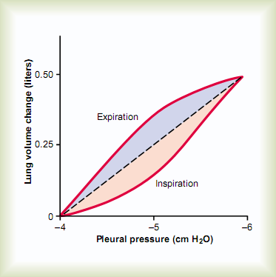

Slide 43
APPLIED PHYSIOLOGY
Increase in Compliance
Decrease in Compliance
Physiological condition:
Old age due to loss of elastic property of lung tissues.
Pathological condition: Emphysema -only condition in which there is loss of membranes and loss of elastic tissue.
Decreased compliance means lungs are difficult to expand.
Decreased lung compliance occurs in fibrosis, atelectasis, COPD, effusion , Bony deformities kyphosis, scoliosis, surfactant deficiency, respiratory muscle weakness.

Slide 44
TYPES OF COMPLIANCE
STATIC COMPLIANCE: This is assessed while the individual is holding their breath.
DYNAMIC COMPLIANCE: This measurement occurs during normal breathing.
SPECIFIC COMPLIANCE: It refers to the compliance measured per liter of lung volume.
Specific Compliance = Compliance of the lungs / Functional Residual Capacity

Slide 45
Work of Breathing
“Work of breathing is the work done by respiratory muscles during breathing to overcome the resistance in thorax and respiratory tract.”

Slide 46
WORK DONE BY RESPIRATORY MUSCLES
During respiratory processes, inspiration is active process and the expiration is a passive process.
So, during quiet breathing, respiratory muscles perform the work only during inspiration and not during expiration

Slide 47
Work of Breathing
65% of work of breathing is to overcome elastic recoil tendency of the lungs and this is called the elastic work or compliance work.
28% of work of breathing is to overcome the airway resistance. Medium and large sized airways offer most of the airway resistance not terminal bronchioles.
7 % of work of breathing is to overcome the tissue resistance

Slide 48
PROTECTIVE REFLEXES
Dr. Tabish Masood Ranjha

Slide 49
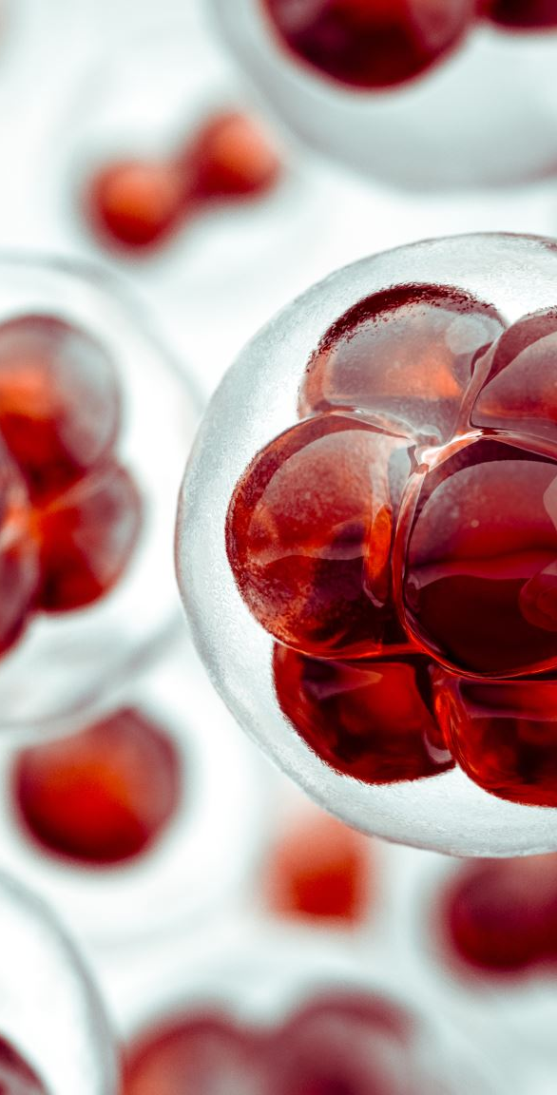
PROTECTIVE REFLEXES
Triggered by receptors in epithelium of respiratory tract when lungs are exposed to:
toxic vapors
chemicals irritants
mechanical stimulation
Cause sneezing, coughing, and laryngeal spasm

Slide 50
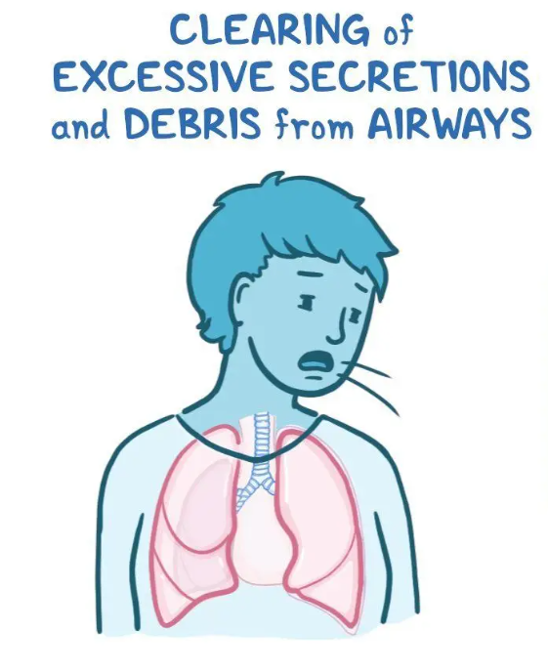
Cough Reflex
Stimulus: foreign particle, noxious chemical, SO₂, Cl₂gas
Receptors:
Trachea/ Bronchi: touch receptors
Terminal bronchioles/ alveoli: chemical receptors
Afferents(sensory): Vagus Nerve
Centre: Medulla
Efferents(motor): vagus (10th cranial), Phrenic Nerve, Intercostal Nerves
Effector Organs: Epiglottis, Vocal Cords, Abdominal Muscles, Intercostals

Slide 51
Mechanism and significance of cough
Deep inspiration (2.5 L)
Forced expiration against a closed glottis
Intrathoracic pressure increases to 100 mm Hg or more
Glottis opened
Explosive outflow of air (75-100 miles/hr)

Slide 52
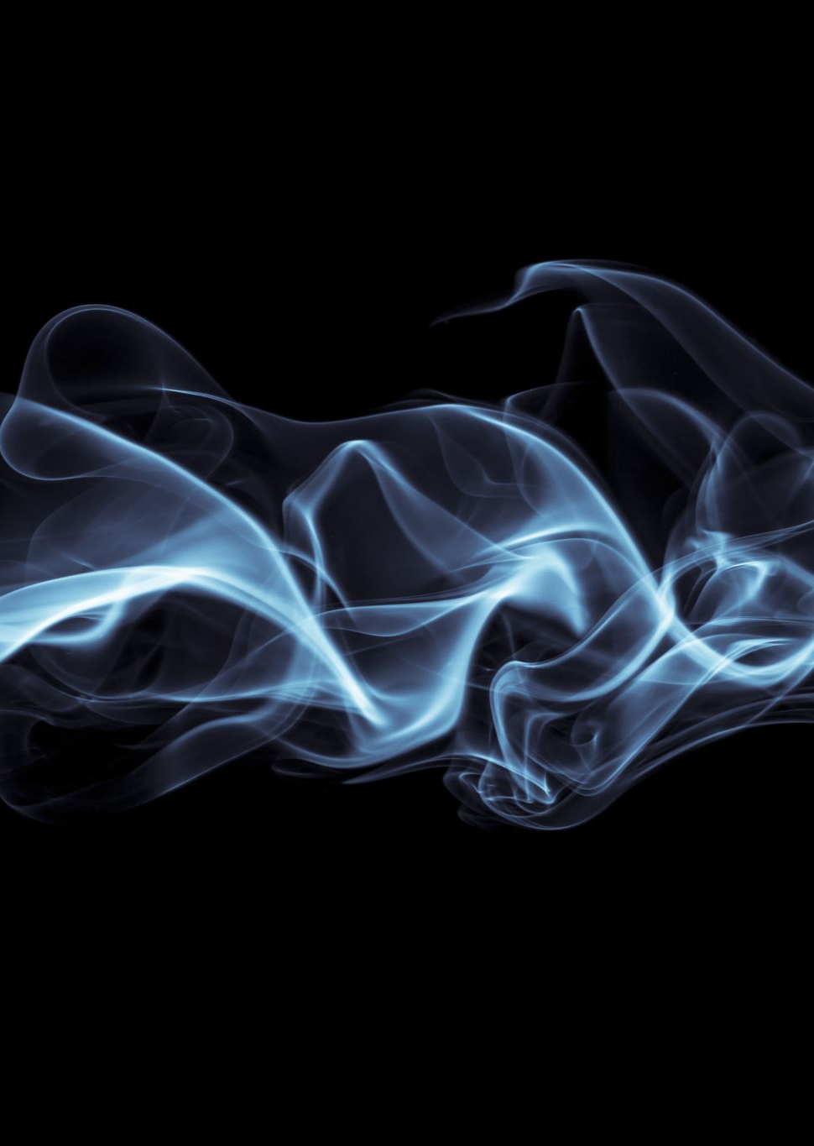
Smokers are less sensitive to cough-inducing irritants, which may have important medical implications.

Slide 53
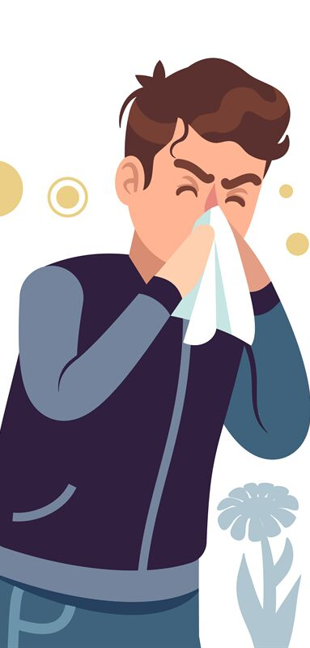
Sneeze Reflex
Receptors: Nasal Passages
Afferents: 5th Cranial Nerve (Trigeminal Nerve) responsible for mastication
Centre : Medulla
Efferents: Vagus (10th cranial), Accessory(11th cranial), Phrenic Nerve, Intercostal Nerves
Effector Organs: Uvula, Epiglottis, Vocal Cords, Abdominal Muscles, Intercostals
Depression of uvula helps passage of air rapidly through naso-pharynx
Nasal passages are cleared of irritants

